Slide 1
Hands-On Stateflow Workshop
Please grab a thumb drive & copy its contents to your desktop or some other directory where you have write permission.
<Rep’s Name>, Account Manager
<Presenter’s Name>, Application Engineer
<TA’s Name>, Application Engineer

Slide 2
Agenda
What is a workshop?
3-4 hours of hands-on experience with Stateflow
Material that you can re-use at your desk
Sufficient information to get you started
The MathWorks offers a full day course in Stateflow for a more thorough introduction to the semantics of Stateflow
Background Information
MATLAB
Simulink
Case Study
Follow-On Information
Getting more information
Training

Slide 3
Why Stateflow?
Some key words/phrases to listen for
Reactive control systems
Control system logic
Finite state machines
Scheduling
Fault detection
Event driven systems
Some examples?

Slide 4
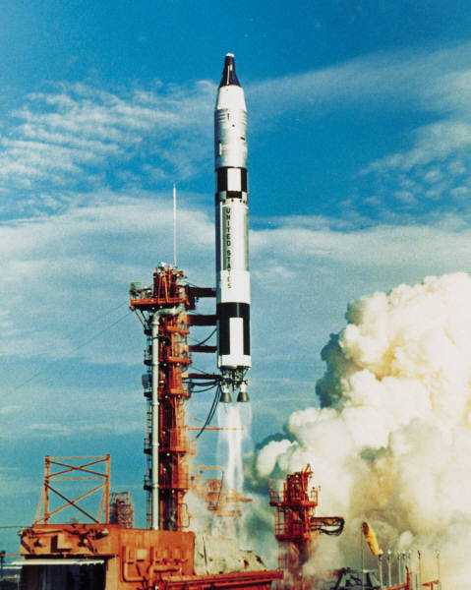
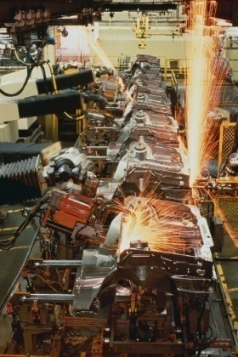
How does Stateflow work with Simulink?
Simulink is used to respond to continuous changes in dynamic systems.
Stateflow is used to respond to instantaneous changes in dynamic systems.
Real-world systems have to respond to both continuous and instantaneous changes.
suspension dynamics gear changes
propulsion system liftoff stages
robot kinematics operation modes
Use both Simulink and Stateflow so that you can use the right tool for the right job.
Notes:
This is the elevator pitch for Stateflow.
Simulink is used to respond to continuous changes in dynamic systems.
Stateflow is used to respond to instantaneous changes in dynamic systems.
Real-world systems have to respond to both continuous and instantaneous changes.
For example, a car has continuous suspension dynamics and instantaneous gear changes.
A rocket has a propulsion system that changes continuously with time and distinct liftoff stages that change instantaneously.
Robots move in a continuous fashion, but have distinct modes of operation.
The point is that in order to model real-world systems, you should have both Simulink and Stateflow.

Slide 5
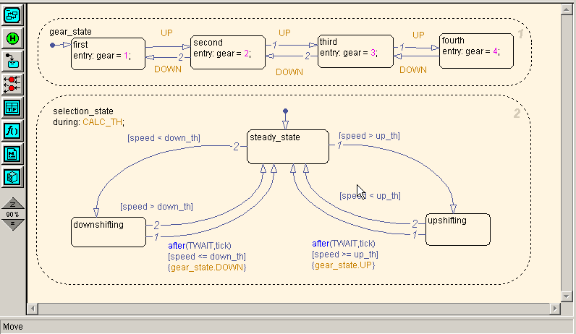
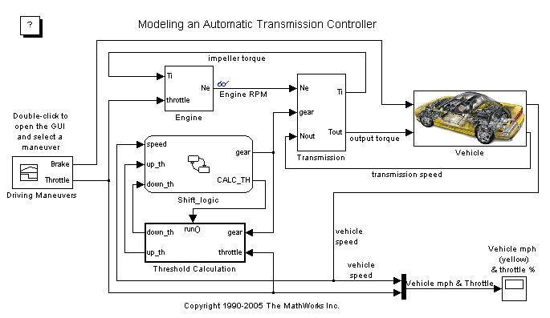
Stateflow Overview
Extend Simulink with a design environment for developing state machines and flow charts
Design systems containing control, supervisory, and mode logic
Describe logic in a natural and understandable form with deterministic execution semantics
Notes:
Stateflow is an interactive design and simulation tool for event-driven systems. Stateflow provides the language elements required to describe complex logic in a natural, readable, and understandable form. It is tightly integrated with MATLAB® and Simulink®, providing an efficient environment for designing embedded systems that contain control, supervisory, and mode logic.
Stateflow charts enable the graphical representation of hierarchical and parallel states and the event-driven transitions between them. Stateflow augments traditional state charts with the innovative capabilities of control flow, MATLAB and graphical functions, truth tables, temporal operators, directed-event broadcasting, and support for integrating hand-written C code.
Stateflow is tightly integrated with MATLAB and Simulink. Using Stateflow, you can design the control, supervisory, and mode logic and send the output to a Simulink model, which then solves the dynamics of the problem at hand. For example, in an automatic transmission, Stateflow models the 4 gears of the transmission. The dynamics of the Simulink model changes based on the gear of the transmission. Once you run your simulation, you can use MATLAB for data processing and data visualization.

Slide 6
What is a finite state machine?
A representation of a reactive system that contains a finite number of states
System changes states based on defined conditions
Examples:
Automatic transmission:
First, second, third, and fourth gears
Actuator in a fault detection, isolation, and recovery system:
Active, standby, off, isolated
Robot arm
Initialization, normal mode, or shutdown
Notes:
A finite state machine is a representation of a reactive system. In an event-driven system, the system makes a transition from one state (mode) to another prescribed state, provided that the condition defining the change is true.
For example, you can use a state machine to represent a car's automatic transmission. The transmission has a number of gear states; for example, from first to fourth gear. As the driver shifts from one gear to another the system makes a transition from one state to another, effecting the dynamics of the entire vehicle.
Traditionally, designers used truth tables to represent relationships among the inputs, outputs, and states of a finite state machine. The resulting table describes the logic necessary to control the behavior of the system under study. Another approach to designing event-driven systems is to model the behavior of the system by describing it in terms of transitions among states. The state that is active is determined based on the occurrence of events under certain conditions. State-transition diagrams and bubble diagrams are graphical representations based on this approach.

Slide 7
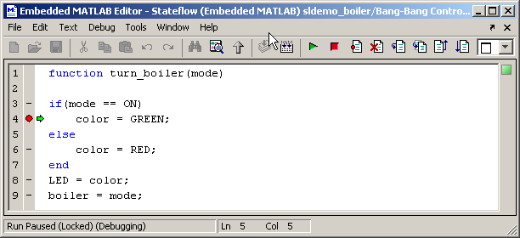
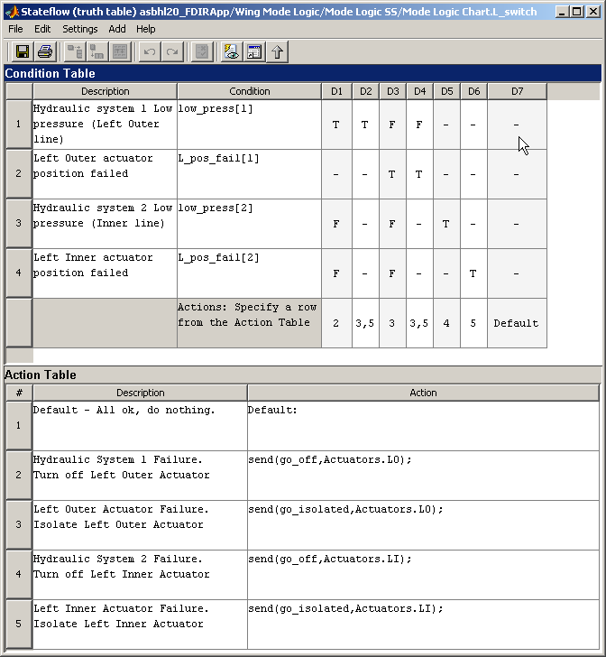
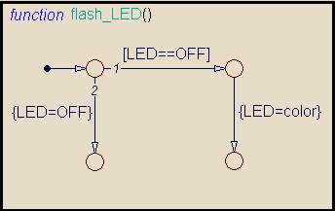
Key Features
Defines functions
Procedurally, using the MATLAB language
In tabular form, with truth tables
Graphically, using flow diagrams
Provides language elements, hierarchy, and parallelism
Animates Stateflow® charts to enhance understanding of the system
Incorporates custom and legacy C code with input and output arguments
Performs static and run-time checks
Supports Mealy and Moore finite state machines
Notes:
A Stateflow chart is a graphical representation of a finite state machine where states and transitions form the building blocks of the system.
Stateflow lets you include functions within your chart. Functions in Stateflow are useful for the same reasons that they are useful in any other programming language: you define a program once in a function, but call it as many times as you need in the Stateflow action language. This provides convenience and power to the Stateflow action language. You can define and use three types of functions:
Graphical functions let you graphically program an algorithm and track its behavior during simulation.
Embedded MATLAB functions let you call MATLAB functions for data analysis and visualization. You can also use an embedded subset of the MATLAB language to define embedded, matrix-oriented algorithms.
Truth tables let you specify functions with combinational logic in a concise, tabular form without drawing flow diagrams.
Hierarchy enables you to organize complex systems by defining a parent/offspring object structure; i.e., you can organize states within other higher-level states. For example, at the highest level of hierarchy, a system can be either on or off. But within the On state, there can be many other substates defined (e.g., charging, low_battery, running, idle, etc.)
A system with parallelism can have two or more orthogonal states active at the same time. For example, a system can contain four components that are active at the same time. Each of these four components can be represented in a Stateflow diagram by its own parallel state.
One of the most powerful features of Stateflow is that as the simulation runs, the Stateflow chart animates to show you exactly which state the machine is in at each time step. This animation can be used in conjunction with the Stateflow debugger to check if the Stateflow chart is following expected behavior (e.g., if transitions are taking place when you expect them to).
You can also incorporate existing hand-written C code functions into your Stateflow chart by calling the functions in your states or transitions.
Static checks are performed as you design your Stateflow chart. For example, if you create an over- or under-specified truth table, Stateflow will give you a warning message before you try to run the simulation. Run-time errors can also be detected with the debugger. These include state inconsistencies, transition conflicts, data range violations, potential infinite loops, and ill-specified truth tables.
You can specify your Stateflow chart into one of three machine classes: Mealy, Moore, or a Mealy-Moore hybrid with extended functionality. Mealy and Moore machines are especially useful for C and HDL code generation for signal processing and communications applications.

Slide 8
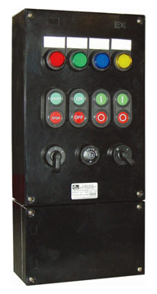
Case Study Introduction
Our “device” generates heat when it is switched on.
We need to develop some control logic to:
Turn an internal fan on & off
Determine fan speed
Detect a fault with the primary fan and activate a backup
Automatically turn the device off if the temperature is too high

Slide 9
Working with the demo & script
Copy the “Class” folder onto your desktop
Open MATLAB and navigate to the “Class” directory
Run the “start_sfWorkshop.m” file
Files are copied from the “source” to “work” directory
If you modify the files in the “work” directory, you always have the “source” files as a backup.
MATLAB changes into the “work” directory & opens an HTML script.
The HTML script provides instructions on how to go from one step to another & provides a fail-safe in case you don’t complete a step.

Slide 10
Enough with the slides already, let’s see some Stateflow!

Slide 11
Summary
For more information
<Rep’s Name>
<Rep’s Email>@mathworks.com
<Rep’s Number>
http://www.mathworks.com/products/stateflow/
Support
508-647-7000
support@mathworks.com
MathWorks training courses
Stateflow training is 1 full day
http://www.mathworks.com/services/training/index.html
Demos & Webinars
http://www.mathworks.com/products/stateflow/demos.html

